Slide 1
19CSE202 DATABASE MANAGEMENT SYSTEMS (DBMS)
Introduction To Relational Model
QUIZ
Dr. Sikha O K
Assistant Professor(Sr.Gr)
Computer Science and Engineering Dept
ASE-Coimbatore

Slide 2
Quiz 1: CSE A,B
Q1
A database which consists of more than one linked table is called a...
BTL1
flat file database
relational database
linked database
validated database

Slide 3
Quiz 1
Q1
A database which consists of more than one linked table is called a...
BTL1
flat file database
relational database
linked database
validated database
Relational database

Slide 4
Quiz 1 CSE A,B
Q2
In a database table, the field which is identified as being a unique identifier for each record is called the... BTL1

Slide 5
Quiz 1
Q2
In a database table, the field which is identified as being a unique identifier for each record is called the... BTL1
Primary Key

Slide 6
Quiz 1 CSE A,B
Q3
Fill in the blanks and give proper label BTL2
Degree=
Cardinality=
2
1
Employee
Teacher ID | Fname | Lname
B002 | David | Warner
B017 | Sara | Joseph
B009 | Mike | Brunton
4
3
5
6

Slide 7
Quiz 1
Q3
Fill in the blanks and give proper label BTL1
Degree=
Cardinality=
Attributes
Relation
Employee
Teacher ID | Fname | Lname
B002 | David | Warner
B017 | Sara | Joseph
B009 | Mike | Brunton
B008 | Nathan | Kurtz
Primary Key
Tuples
3
4

Slide 8
Quiz 1 CSE C,D
Q1
BTL2
Fill in the blanks:
A ___________ is an attribute or a group of multiple attributes (any combination) that can uniquely identify a tuple
Super Key
[ NOTE: Give answer in lower case letters ]

Slide 9
Quiz 1 CSE C,D
Q1
Choose the correct statement regarding superkeys
a) A superkey is an attribute or a group of multiple attributes that can uniquely identify a tuple
b) A superkey is a tuple or a set of multiple tuples that can uniquely identify an attribute
c) Every superkey is a candidate key
d) A superkey is an attribute or a set of attributes that distinguish the relation from other relationsBTL2
Answer: a Explanation: A superkey is an attribute or a set of multiple attributes that can uniquely identify a tuple. It is used to differentiate between tuples.

Slide 10
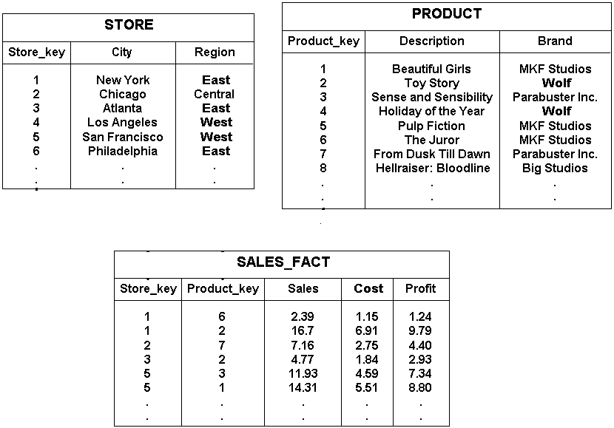
Quiz 1
BTL2
Q2

Slide 11
Quiz 1
BTL2
Q2
Identify Primary Key, Foreign Key , Referencing Relation and Referenced Relation for the following relations

Slide 12
Quiz 1 CSE C,D
Q3
BTL2
Find the anomaly in the following relation
ANS: Entity Integrity Constraint
Department
Department_name​ | Building​ | Budget​
CSE​ | AB3​ | 15000000​
Mechanical​ | AB1​ | 1600000​
​ | AB2​ | 15000000​

Slide 13
Quiz 1 CSE C,D
Q4
BTL2
Find the anomaly in the following relations
ANS: Referential Integrity
Department
Department_name​ | Building​ | Budget​
CSE​ | AB3​ | 15000000​
Mechanical​ | AB1​ | 1600000​
​Physics | AB2​ | 15000000​
Employee
ID​ | Name​ | Department_name​ | Salary​
1​ | Anu​ | CSE​ | 40000​
2​ | Sarath​ | Mechanical​ | 42000​
3​ | Harish​ | CSE​ | 38000​
4​ | Arun​ | EEE​ | 39000​

Slide 14
Quiz 1 CSE C,D
Q3
Fill in the blanks and give proper label BTL2
Degree=
Cardinality=
2
1
Employee
Teacher ID | Fname | Lname
B002 | David | Warner
B017 | Sara | Joseph
B009 | Mike | Brunton
4
3
5
6

Slide 15
Quiz 1 CSE E,F
Q1
The term _______ is used to refer to a row in relation.
ANS: Tuple
[ NOTE: Give answer in lower case letters ]

Slide 16
Quiz 1 CSE E,F
Q2
Course(course_id,sec_id,semester)
Here the course_id,sec_id and semester are ___(1)_______ and course is a ___(2)_______
ANS: (1) Attribute
(2) Relation
[ NOTE: Give answer in lower case letters ]

Slide 17
Quiz 1 CSE E,F
Q3
For each attribute of a relation, there is a set of permitted values, called the ________ of that attribute.
ANS: Domain
[ NOTE: Give answer in lower case letters ]

Slide 18
Quiz 1 CSE E,F
Q4
The tuples of the relations can be of ________ order.
a) Any
b) Same
c) Sorted
d) Constant
ANS: Any

Slide 19
Quiz 1 CSE E,F
Q5
A _______________ key is a minimal super key
ANS: Candidate key
[ NOTE: Give answer in lower case letters ]

Slide 20
Quiz 1 CSE E,F
Q6
Which one of the following attribute can be taken as a primary key?
ANS: id

Slide 21
Quiz 1 CSE E,F
Q7
Consider attributes ID , CITY and NAME . Which one of this can be considered as a candidate key?
name
id
city
city,id
ANS: id

Slide 22
Quiz 1 CSE E,F
Q8
Which Integrity is getting violated here
entity integrity (ANS)
key integrity
domain integrity
Referential integrity
Employee
Teacher ID | Fname | Lname
B002 | David | Warner
B017 | Sara | Joseph
 | Mike | Brunton

Slide 23
Quiz 1 CSE E,F
Q9
Find the schema given below and fill the blanks BTL2
(1) Primary key for the schema is ________ : stu_no
(2) Stu_name is a __________ attribute : composite
(3) Give an example for multi valued attribute in the above schema : email
Stu_name | Stu_no | email | State | Country | Stu_Age

Slide 24
ACTIVITY
Video Courtesy
Cambridge GCSE Computing Online
Worksheet 1

Slide 25
THANK YOU

